Slide 1
Accessing the Curriculum for diverse learners
Literacy Development – Adapting Books

Slide 2
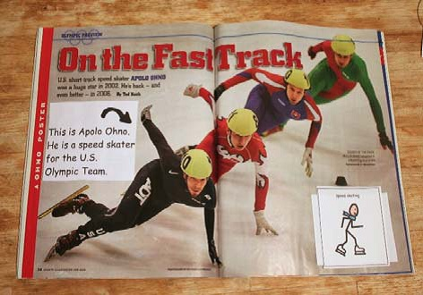
Adapting Books: Why?
Engagement and Active Participation
Focus Attention
Cognitive Access

Slide 3
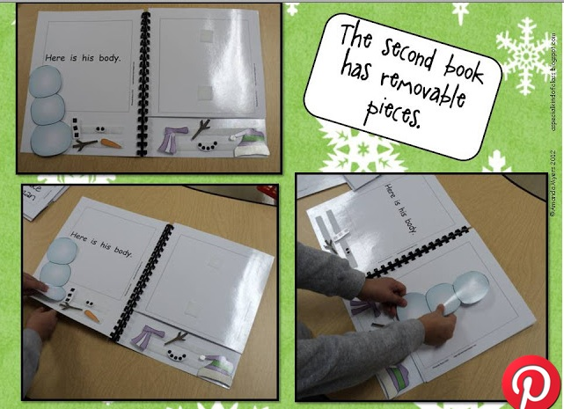
Active Engagement
Choose books that encourage interaction:
Manipulate book
Repetitive books
Known books
Books you make
Low language demands

Slide 4
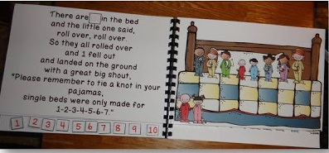
Active Engagement
Allow the student to manipulate the book:
Hold book
Turn pages
Accept all types of participation
Pause to let student participate

Slide 5
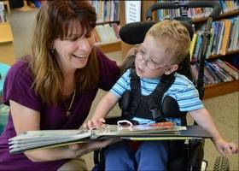
Supported book reading
Often the most overlooked area for students with (significant) disabilities, yet this type of reading is critical to success
An adult supports the experience
May need to physically adapt book or make the content / text more accessible

Slide 6
Adapting Books: Two Types
Physical
May not be able to hold / manipulate book
Book may be too “fragile” for students’ motor planning
Content
Not able to read the words
May have no pictures in older grades
Short attention span vs. amount of text if read aloud
Limited receptive vocabulary
May need to add in visual or tactile cues

Slide 7
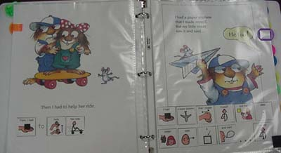
Adding Symbols
Attach a strip with symbols to the bottom of the page
While reading point to symbols
Could have a duplicate set to do an activity that involves the student

Slide 8
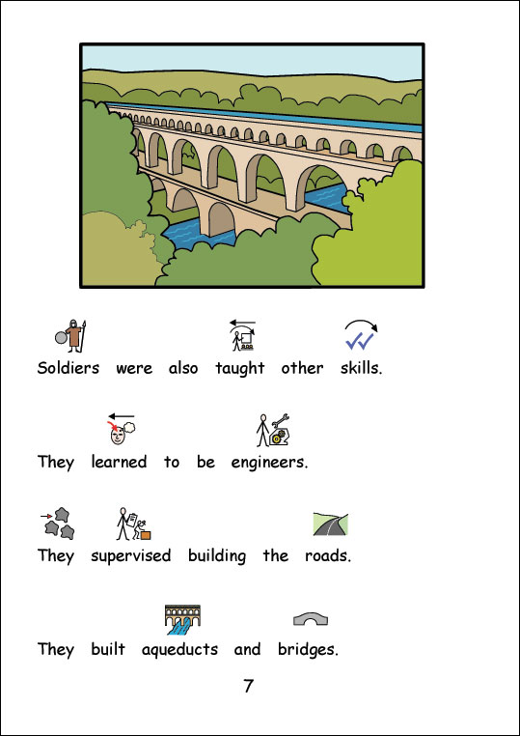
Symbol stories

Slide 9
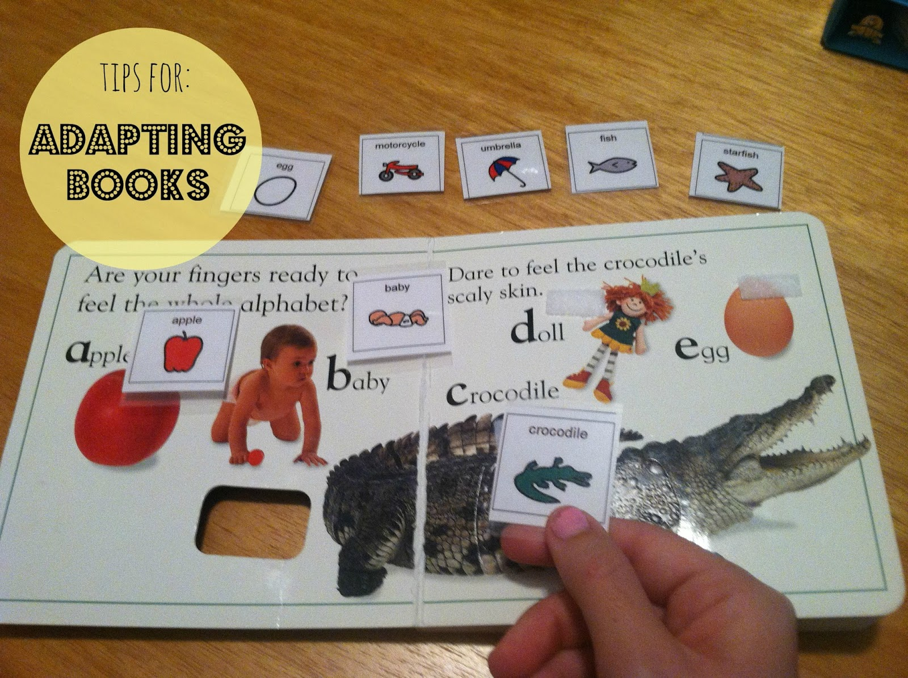
Props
Keep hands busy
Support attention and focus
Pictures, symbols, figures, puppets, etc.
Can introduce matching or identification activities
Be organized – keep everything together (attach labeled Ziploc bag into front cover)

Slide 10
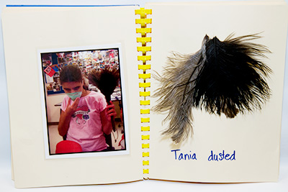
Tactile Experience Books
Personalize about a student or an event
Include items from the event
Affix objects to page
Keep simple
Large objects can be stored in Ziploc bags that are attached to a page

Slide 11
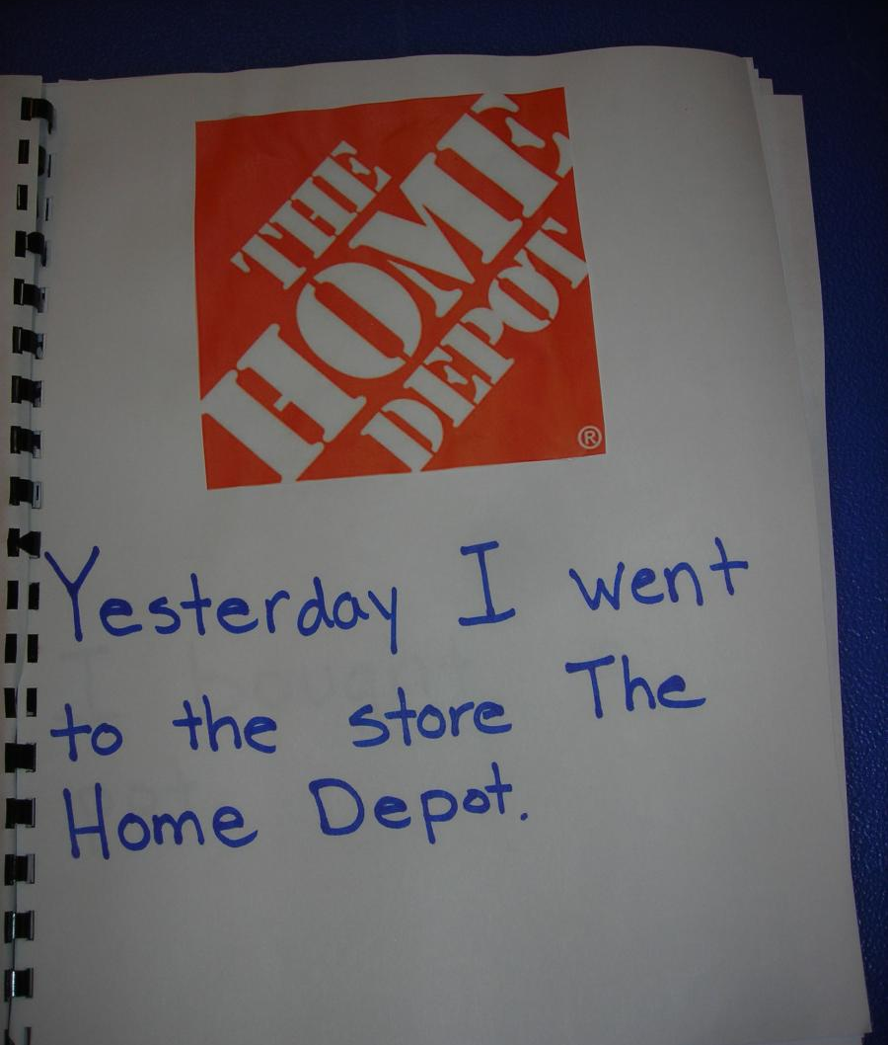
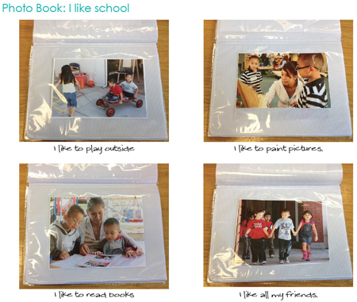
Experience Books

Slide 12
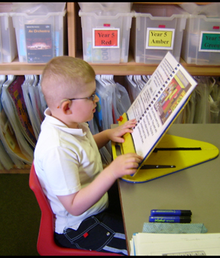
Accessibility of Books
Place on an easel or flip chart
Page fluffers can be used to add spaces between each page for easy page turning

Slide 13
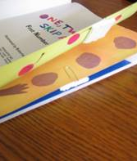
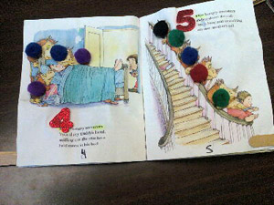
Accessibility of Books

Slide 14
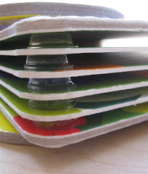
Durability
Take commercial books apart and laminate pages
Laminate home made books
Use page protectors
Put all pages into a ring binder – creates ease for reading as the pages will stay open as you are telling the story
(Board books are ok for preschoolers and K-students only)

Slide 15

Activity: online resources
Work in small groups
Explore your assigned website about books online
Create a poster that includes:
name and address of site
Description
Example
Skills needed to use resources
What age group would benefit from these resources?
Visual
Put up your poster

Slide 16
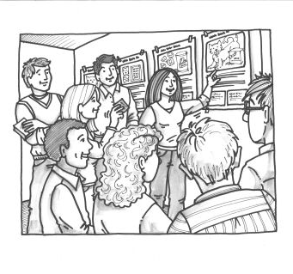
Activity: Gallery Walk
Go to each poster about a website related to books online
Take notes so that when the walk is over you have an idea of what resources are available to you as you support literacy development

Slide 17
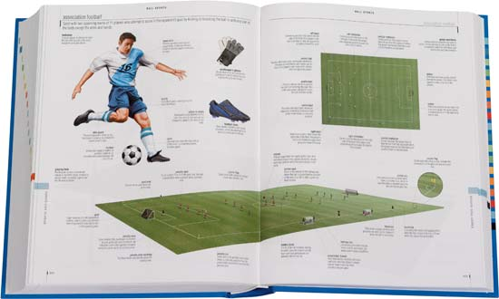
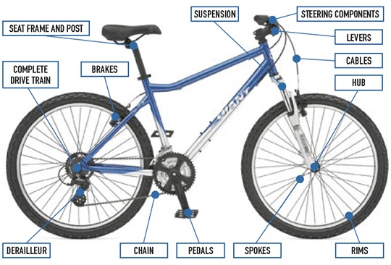
Commercial Products

Slide 18


Commercial Products

